Slide 1
CS 2160 Parallel Processors
Chapter 6

Slide 2
Introduction
§9.1 Introduction
Goal: connecting multiple computers to get higher performance
Multiprocessors
Scalability, availability, power efficiency
Job-level (process-level) parallelism
High throughput for independent jobs
Parallel processing program
Single program run on multiple processors
Multicore microprocessors
Chips with multiple processors (cores)
502

Slide 3
Hardware and Software
Hardware
Serial: e.g., Pentium 4
Parallel: e.g., quad-core Xeon e5345
Software
Sequential: e.g., matrix multiplication
Concurrent: e.g., operating system
Sequential/concurrent software can run on serial/parallel hardware
Challenge: making effective use of parallel hardware
503

Slide 4
What We’ve Already Covered
§2.11: Parallelism and Instructions
Synchronization
§3.6: Parallelism and Computer Arithmetic
Associativity
§4.10: Parallelism and Advanced Instruction-Level Parallelism
§5.8: Parallelism and Memory Hierarchies
Cache Coherence
§6.9: Parallelism and I/O:
Redundant Arrays of Inexpensive Disks
504

Slide 5
Parallel Programming
Parallel software is the problem
Need to get significant performance improvement
Otherwise, just use a faster uniprocessor, since it’s easier!
Difficulties
Partitioning
Coordination
Communications overhead
§7.2 The Difficulty of Creating Parallel Processing Programs
504

Slide 6
Amdahl’s Law
Sequential part can limit speedup
Example: 100 processors, 90× speedup?
T_{new} = T_{parallelizable}/100 + T_{sequential}
90-90F+.9F = 1
89 = 90F-.9F
F = 89/89.9
~ 0.999
Need sequential part to be 0.1% of original time
505

Slide 7
Strong vs Weak Scaling
Strong scaling: problem size fixed
Weak scaling: problem size proportional to number of processors
I.e., parallelizing the solution adds processing overhead
507

Slide 8
Flynn’s Taxonomy
 |  | Data Streams
 |  | Single | Multiple
Instruction Streams | Single | SISD: Intel Pentium 4 | SIMD: SSE instructions of x86
 | Multiple | MISD: No examples today | MIMD: Intel Xeon e5345
SPMD: Single Program Multiple Data
A parallel program on a MIMD computer
Conditional code for different processors
509

Slide 9
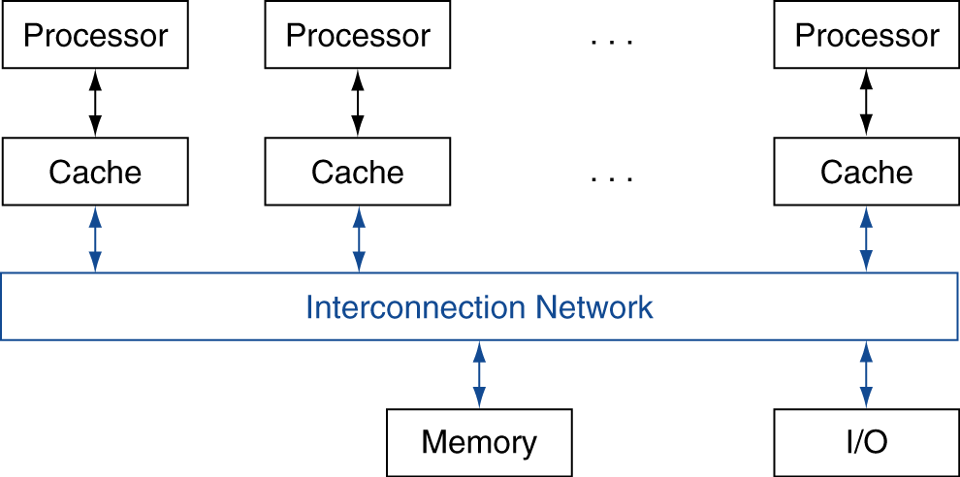
Shared Memory
SMP: shared memory multiprocessor
Hardware provides single physical address space for all processors
Synchronize shared variables using locks
Memory access time
UMA (uniform) vs. NUMA (nonuniform)
§7.3 Shared Memory Multiprocessors
510

Slide 10
SIMD
Operate elementwise on vectors of data
E.g., MMX and SSE instructions in x86
Multiple data elements in 128-bit wide registers
All processors execute the same instruction at the same time
Each with different data address, etc.
Simplifies synchronization
Reduced instruction control hardware
Works best for highly data-parallel applications
511

Slide 11
Vector Processors
Highly pipelined function units
Stream data from/to vector registers to units
Data collected from memory into registers
Results stored from registers to memory
Example: Vector extension to MIPS
32 × 64-element registers (64-bit elements)
Vector instructions
lv, sv: load/store vector
addv.d: add vectors of double
addvs.d: add scalar to each element of vector of double
Significantly reduces instruction-fetch bandwidth
511

Slide 12
Example: DAXPY (Y = a × X + Y)
Conventional MIPS code
l.d $f0,a($sp) ;load scalar a addiu r4,$s0,#512 ;upper bound of what to load loop: l.d $f2,0($s0) ;load x(i) mul.d $f2,$f2,$f0 ;a × x(i) l.d $f4,0($s1) ;load y(i) add.d $f4,$f4,$f2 ;a × x(i) + y(i) s.d $f4,0($s1) ;store into y(i) addiu $s0,$s0,#8 ;increment index to x addiu $s1,$s1,#8 ;increment index to y subu $t0,r4,$s0 ;compute bound bne $t0,$zero,loop ;check if done
Vector MIPS code
l.d $f0,a($sp) ;load scalar a lv $v1,0($s0) ;load vector x mulvs.d $v2,$v1,$f0 ;vector-scalar multiply lv $v3,0($s1) ;load vector y addv.d $v4,$v2,$v3 ;add y to product sv $v4,0($s1) ;store the result
511

Slide 13
Vector vs. Scalar
Vector architectures and compilers
Simplify data-parallel programming
Explicit statement of absence of loop-carried dependences
Reduced checking in hardware
Regular access patterns benefit from interleaved and burst memory
Avoid control hazards by avoiding loops
More general than ad-hoc media extensions (such as MMX, SSE)
Better match with compiler technology
512

Slide 14
Vector Memory Access
Strided
Constant distance between elements
Indexed
Vector contains addresses which should be loaded
Variable distance between elements

Slide 15
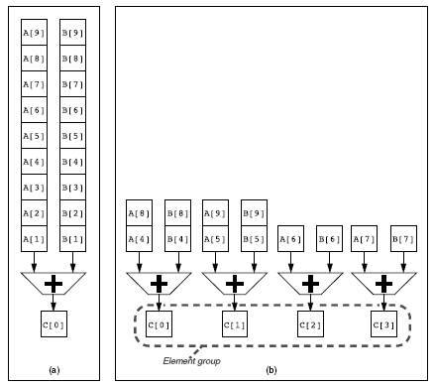
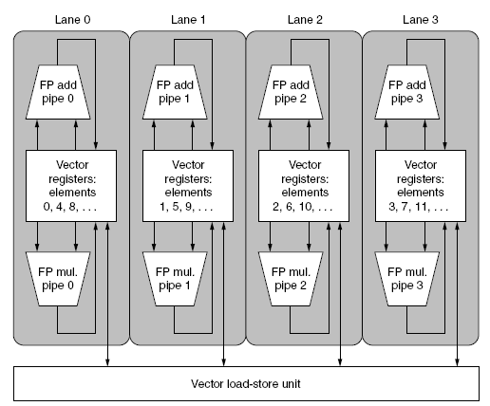
Multiple Lanes
Vector Architectures
Element n of vector register A is “hardwired” to element n of vector register B
Allows for multiple hardware lanes
514

Slide 16
Hardware Multithreading
Hardware Multithreading
Increasing utilization of a processor by switching to another thread when one thread is stalled.
Thread
A thread includes the program counter, the register state, and the stack. It is a lightweight process; whereas threads commonly share a single address space, processes don't.
Process
one or more threads, the address space, and the operating system state. Hence, a process switch usually invokes the operating system, but not a thread switch.
Fine-Grained Multithreading
Switching between threads after every instruction.
Coarse-Grained Multithreading
Switching between threads only after significant events, such as a last-level cache miss.
516

Slide 17
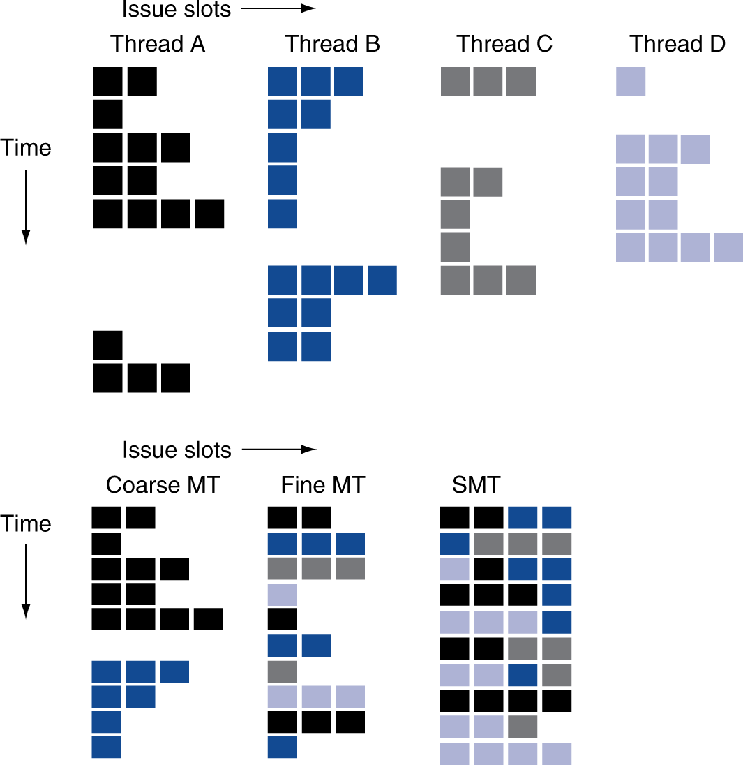
Multithreading Example
517

Slide 18
Multithreading Speedup
518

Slide 19
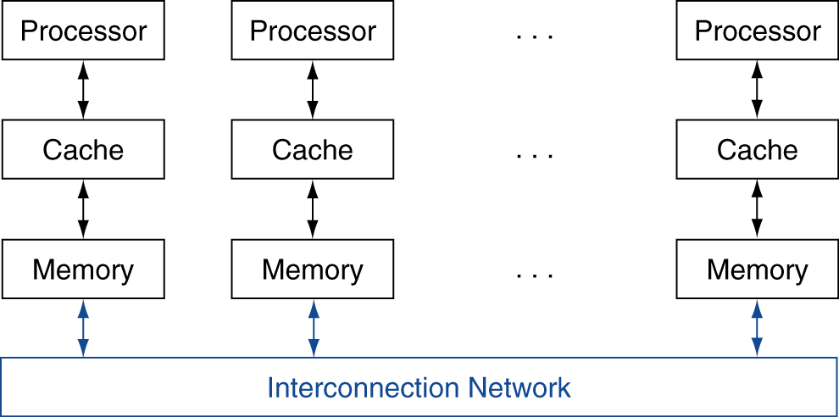
Message Passing
Each processor has private physical address space
Hardware sends/receives messages between processors
§7.4 Clusters and Other Message-Passing Multiprocessors
NUMA
UMA
520

Slide 20
Example: Sum Reduction
Sum 100,000 numbers on 100 processor UMA
Each processor has ID: 0 ≤ Pn ≤ 99
Partition 1000 numbers per processor
Initial summation on each processor
sum[Pn] = 0; for (i = 1000*Pn; i < 1000*(Pn+1); i = i + 1) sum[Pn] = sum[Pn] + A[i];
Now need to add these partial sums
Reduction: divide and conquer
Half the processors add pairs, then quarter, …
Need to synchronize between reduction steps
521

Slide 21
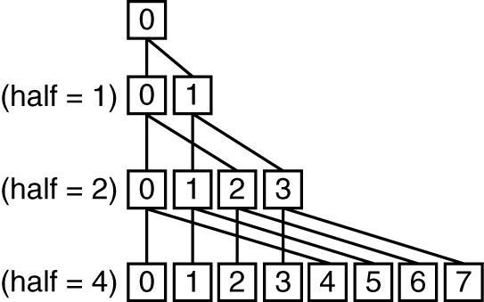
Example: Sum Reduction
half = 100;
repeat
synch();
if (half%2 != 0 && Pn == 0)
sum[0] = sum[0] + sum[half-1];
/* Conditional sum needed when half is odd;
Processor0 gets missing element */
half = half/2; /* dividing line on who sums */
if (Pn < half) sum[Pn] = sum[Pn] + sum[Pn+half];
until (half == 1);
521

Slide 22
Sum Reduction (Again)
Given send() and receive() operations
limit = 100; half = 100;/* 100 processors */ repeat half = (half+1)/2; /* send vs. receive dividing line */ if (Pn >= half && Pn < limit) send(Pn - half, sum); if (Pn < (limit/2)) sum = sum + receive(); limit = half; /* upper limit of senders */ until (half == 1); /* exit with final sum */
Send/receive also provide synchronization
Assumes send/receive take similar time to addition

Slide 23
Synchronization Summary
Is necessary
Slows down the process, but makes it correct
Method (synch barrier or comms bus) makes little difference

Slide 24
Introduction to GPUs
How are GPUs different from CPUs?
GPUs supplement a CPU; there are still serial tasks to be done
GPU problem sizes are typically hundreds of megabytes to gigabytes, but not hundreds of gigabytes to terabytes
Do not rely on multilevel caches to overcome the long latency to memory
Memory is oriented toward bandwidth rather than latency.
Each GPU processor is more highly multithreaded than a typical CPU, plus they have more processors.
525

Slide 25
Introduction to NVIDIA GPUs
526

Slide 26
NVIDIA Fermi Specs
One SIMD instruction, 32 threads, 16 lanes
2 clocks per instruction
Fine-grained multithreading
Thread schedule can schedule any thread in any lane
32K 32-bit registers
2K threads per lane
<= 64 registers per thread
527

Slide 27
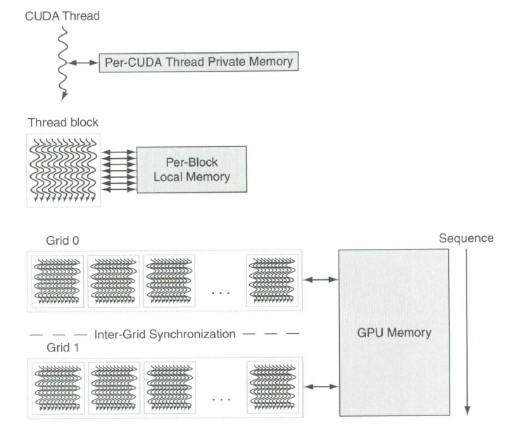
Memory Allocation
528

Slide 28
SIMD CPUs vs SIMD GPUs
529

Slide 29
CPU vs GPU Terminology
530

Slide 30
Clusters, Warehouse-Scale Machines
Machines in a cluster, if working on the same problem must communicate
Communication is non-uniform
Takes longer to communicate with some processors than others
OSs have send routines and receive routines
Synchronous or blocking
Asynchronous or non-blocking
531

Slide 31
Warehouse Scale computing
Used by Google, Amazon, etc
100,000 servers in a warehouse
Huge quantitative difference in size results in qualitative differences
Energy efficiency important
Reliability important
532

Slide 32
Map-Reduce
Method of using massively parallel architectures to solve impossible serial problems
Map: Parallel creation of independent, intermediate results
Reduce: Aggregation of intermediate results into final product
533

Slide 33
Major WSC-Datacenter Differences
WSCs provide one set of applications for a million users, data centers provide a suite of apps for hundreds or maybe thousands of users
WSCs need ample, easy parallelism to be efficient
Operational costs of WSCs are more significant
WSCs have larger economies of scale

Slide 34
Grid Computing
E.g., SETI@home
Started by UC Berkeley in 1999
Leverages ~5 million idle PCs around the world
Centrally coordinated problem solving
3.5 Petaflops and the end of 2011
535

Slide 35


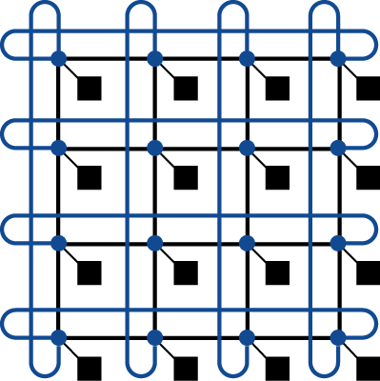

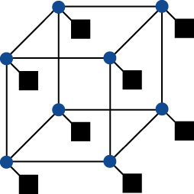
Interconnection Networks
Network topologies
Arrangements of processors, switches, and links
§6.8 Introduction to Multiprocessor Network Topologies
Bus
Ring
N-cube (N = 3)
2D Mesh
Fully connected
536

Slide 36
Some Definitions
Network Bandwidth: the peak transfer rate of a network; often the sum of bandwidth of all the links in the network.
Bisection Bandwidth: The bandwidth between two equal parts of a multiprocessor. This measure is for a worst-case split of the multiprocessor.
Multistage Network: a switch at each node
Crossbar Network: any node can communicate with any other node in one pass through the network
537

Slide 37
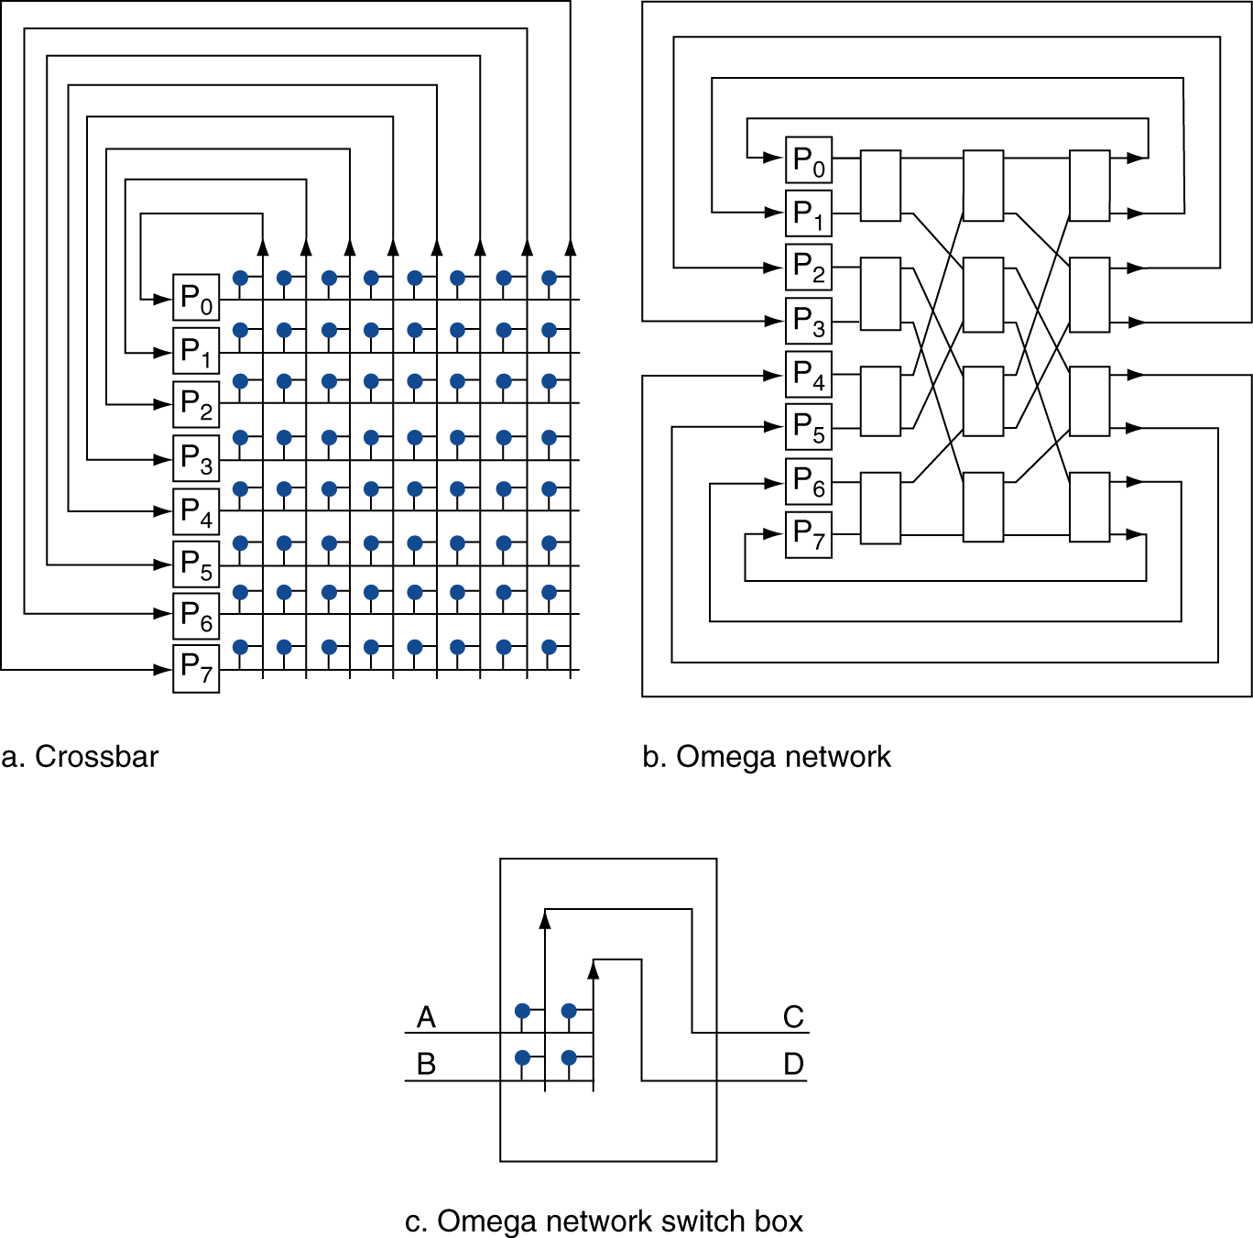
Multistage Networks
539

Slide 38
Network Characteristics
Performance
Latency per message (unloaded network)
Throughput
Link bandwidth
Total network bandwidth
Bisection bandwidth
Congestion delays (depending on traffic)
Cost
Power
Routability in silicon

Slide 39
Code or Applications?
Traditional benchmarks
Fixed code and data sets
Sensitive only to improvements in architecture and compilers
Parallel programming is evolving
Should algorithms, programming languages, and tools be part of the system?
Compare systems, provided they implement a given application
E.g., Linpack, Berkeley Design Patterns
Would foster innovation in approaches to parallelism
540

Slide 40
Parallel Benchmarks
Linpack: matrix linear algebra
SPECrate: parallel run of SPEC CPU programs
Job-level parallelism
SPLASH: Stanford Parallel Applications for Shared Memory
Mix of kernels and applications, strong scaling
NAS (NASA Advanced Supercomputing) suite
computational fluid dynamics kernels
PARSEC (Princeton Application Repository for Shared Memory Computers) suite
Multithreaded applications using Pthreads and OpenMP
§6.10 Multiprocessor Benchmarks and Performance Models
540

Slide 41
Modeling Performance
Assume performance metric of interest is achievable GFLOPs/sec
Measured using computational kernels from Berkeley Design Patterns
Arithmetic intensity of a kernel
FLOPs per byte of memory accessed
For a given computer, determine
Peak GFLOPS (from data sheet)
Peak memory bytes/sec (using Stream benchmark)
542

Slide 42
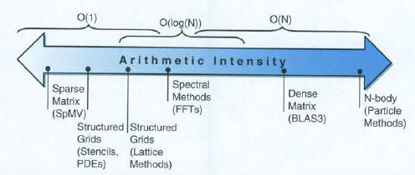
Arithmetic Intensity
543

Slide 43
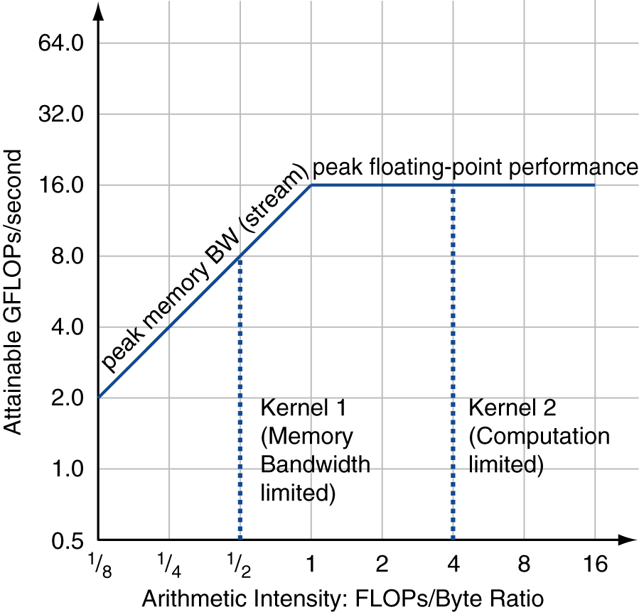
Roofline Diagram
Attainable GPLOPs/sec
= Max ( Peak Memory BW × Arithmetic Intensity, Peak FP Performance )
544

Slide 44
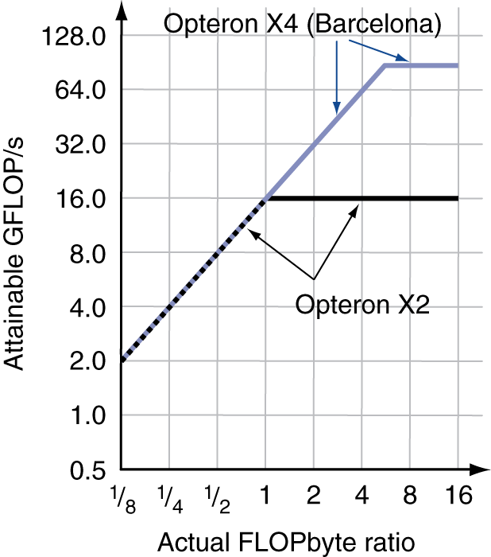
Comparing Systems
Example: Opteron X2 vs. Opteron X4
2-core vs. 4-core, 2× FP performance/core, 2.2GHz vs. 2.3GHz
Same memory system
To get higher performance on X4 than X2
Need high arithmetic intensity
Or working set must fit in X4’s 2MB L-3 cache
546

Slide 45
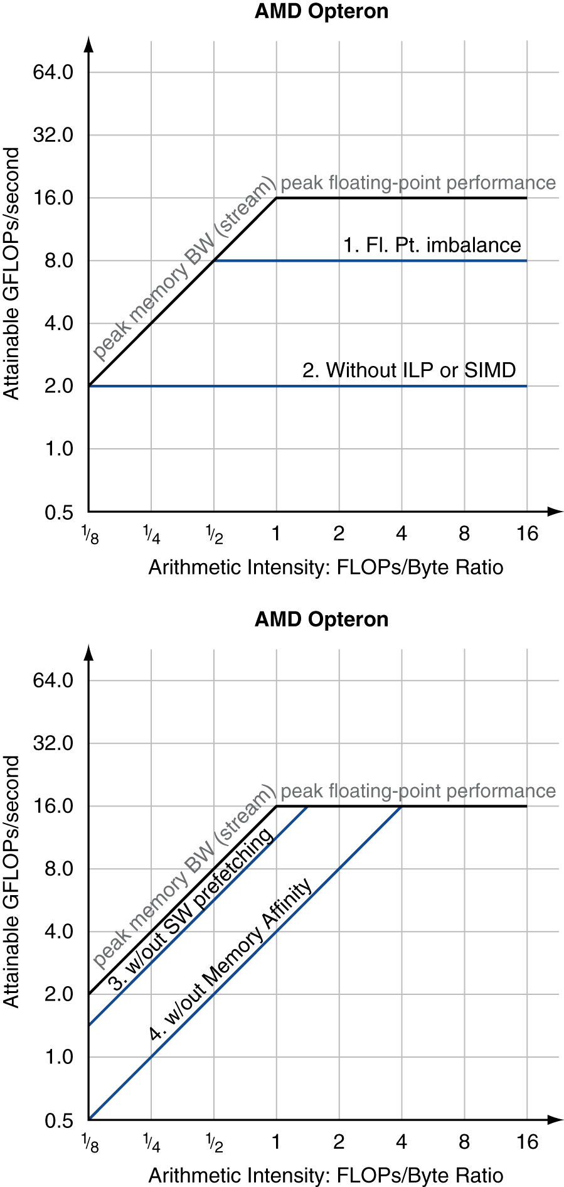
Optimizing Performance
Optimize FP performance
Balance adds & multiplies
Improve superscalar ILP and use of SIMD instructions
Optimize memory usage
Software prefetch
Avoid load stalls
Memory affinity
Avoid non-local data accesses
548

Slide 46
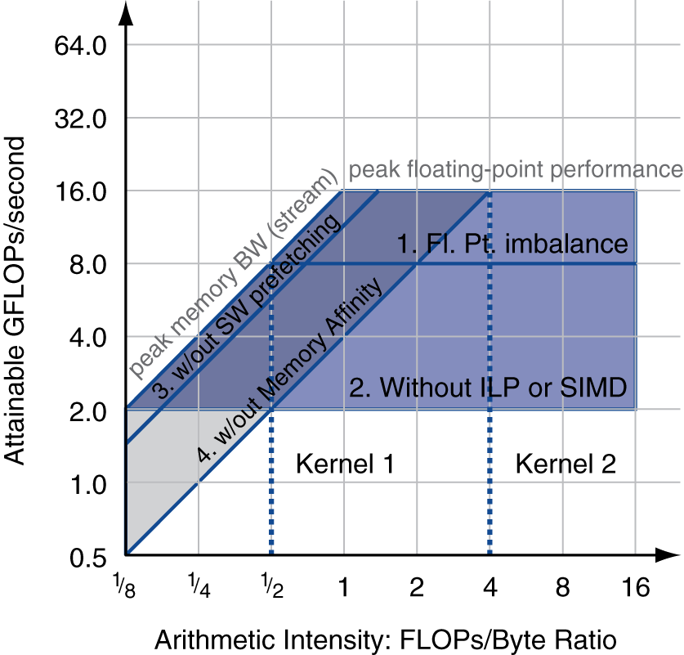
Optimizing Performance
Choice of optimization depends on arithmetic intensity of code
Arithmetic intensity is not always fixed
May scale with problem size
Caching reduces memory accesses
Increases arithmetic intensity
549

Slide 47
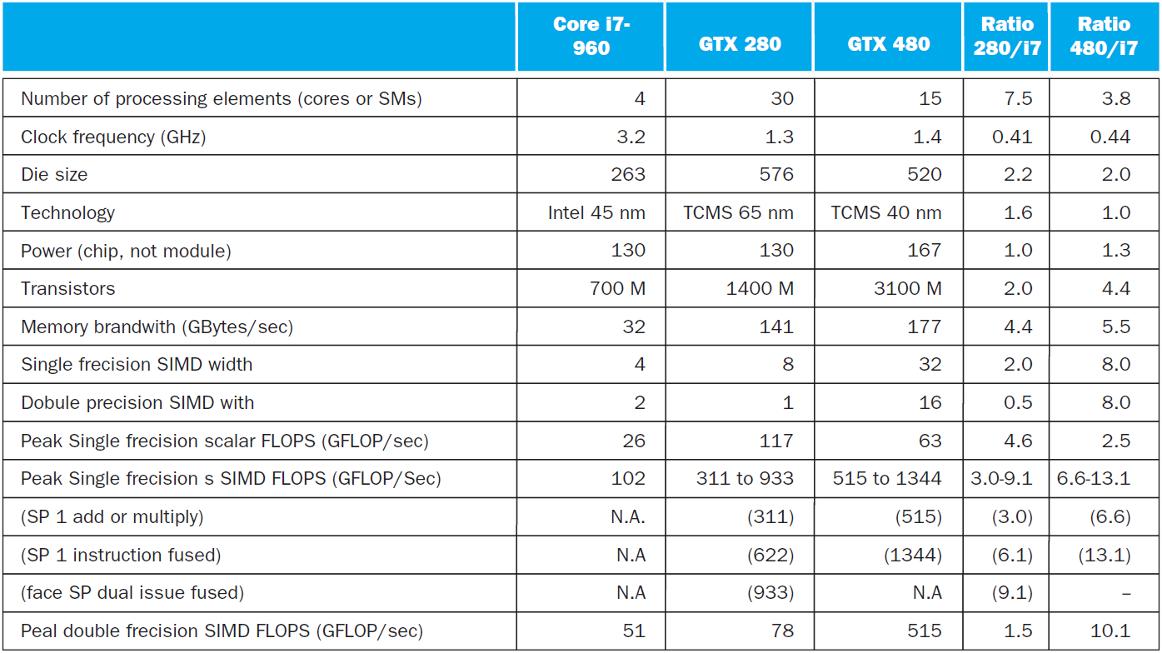
i7-960 vs. NVIDIA Tesla 280/480
§6.11 Real Stuff: Benchmarking and Rooflines i7 vs. Tesla
Typo. Ha ha.
551

Slide 48
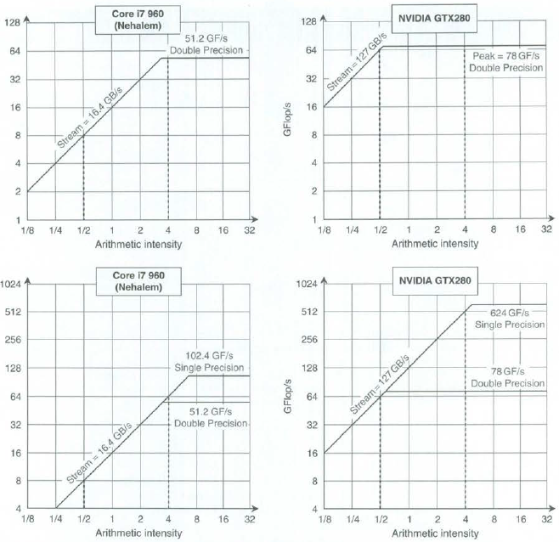
Rooflines
552

